Slide 1
Week 6 - Solutions

Slide 2
Mixtures – a review
Mixture: a combination of two or more substances that do not combine chemically, but remain the same individual substances; can be separated by physical means.
Two types:
  Heterogeneous
  Homogeneous

Slide 3
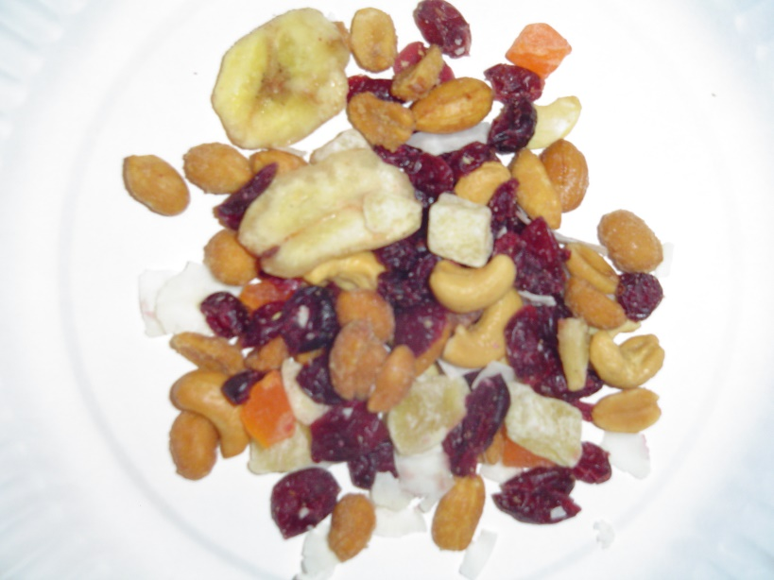
Heterogeneous Mixture
“Hetero” means “different”
Consists of visibly different substances or phases (solid, liquid, gas)
Can be separated by filtering
Example:

Slide 4
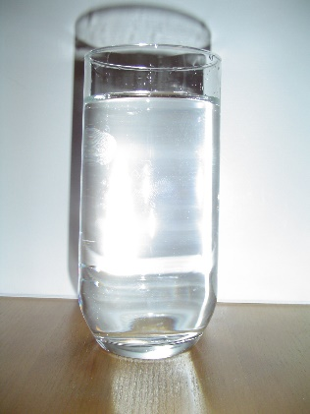
Homogeneous Mixture
“Homo” means the same
has the same uniform appearance and composition throughout; maintain one phase (solid, liquid, gas)
Commonly referred to as solutions
Example:
Salt Water

Slide 5
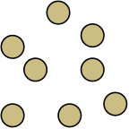
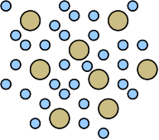
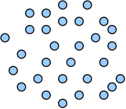
Solution
Solution: a mixture of two or more substances that is identical throughout (homogeneous)
can be physically separated
composed of solutes and solvents
Salt water is considered a solution. How can it be physically separated?
the substance being dissolved
the substance that dissolves the solute
Iced Tea Mix
(solute)
Iced Tea
(solution)
Water
(solvent)

Slide 6
Solution
The solvent is the largest part of the solution and the solute is the smallest part of the solution
S | O | L | V | E | N | T
S | O | L | U | T | E

Slide 7
Types of Solutions
Gaseous solutions – air = Oxygen + Nitrogen
Liquid solutions – drinks = mix + water
Solid solutions – alloys = steel, brass, etc

Slide 8
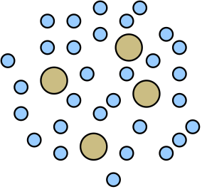
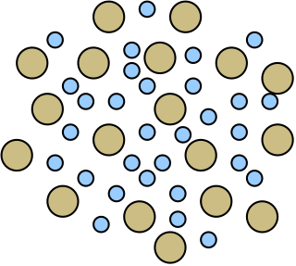
Concentration
the amount of solute dissolved in a solvent at a given temperature
  described as dilute if it has a low concentration of solute dissolved
  described as concentrated if it has a high concentration of solute dissolved

Slide 9
Concentration
  Unsaturated - has a less than the maximum concentration of solute dissolved
  Saturated - has the maximum concentration of solute dissolved (can see solid in bottom of solution)
  Supersaturated -contains more dissolved solute than normally possible (usually requires an increase in temperature followed by cooling)

Slide 10
Solubility
the amount of solute that dissolves in a certain amount of a solvent at a given temperature and pressure to produce a saturated solution

Slide 11
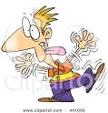
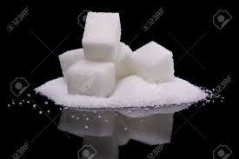
Factors affecting solubility of solids
Temperaturee
Shaking
increased temperature causes
solids to dissolve faster
Shaking (agitation) causes
solids to dissolve faster
Particle Sizee
Smaller particles dissolve
Faster because they have
more surface area
Note: Increasing the amount of solute
DOES NOT increase the rate of dissolving

Slide 12
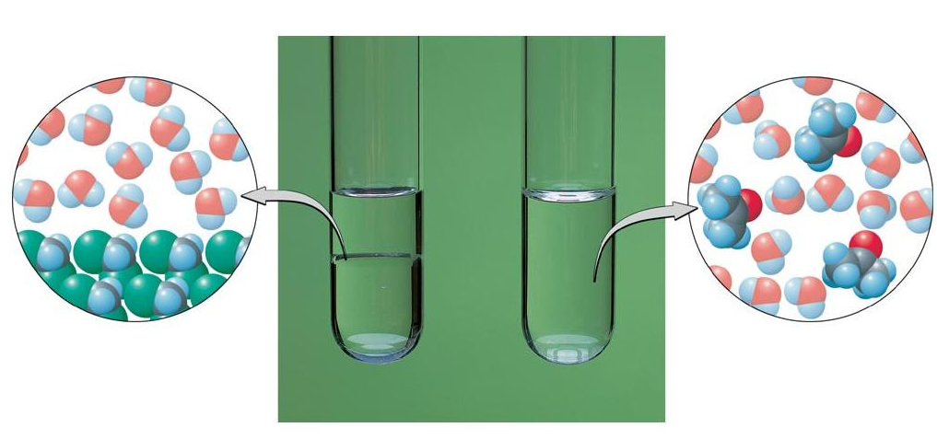
Miscible liquids can easily dissolve in one another.
Immiscible liquids are not soluble in each other.

Slide 13
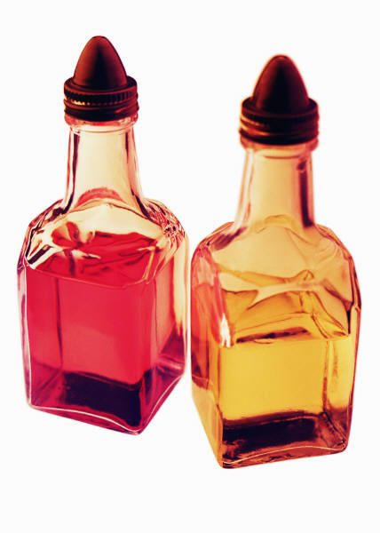
Polarity and Dissolving
Chemists use the saying “like dissolves like”:
  Polar solutes tend to dissolve in polar solvents.
  Nonpolar solutes tend to dissolve in nonpolar solvents.
Oil is nonpolar while water is
polar. They are immiscible.

Slide 14
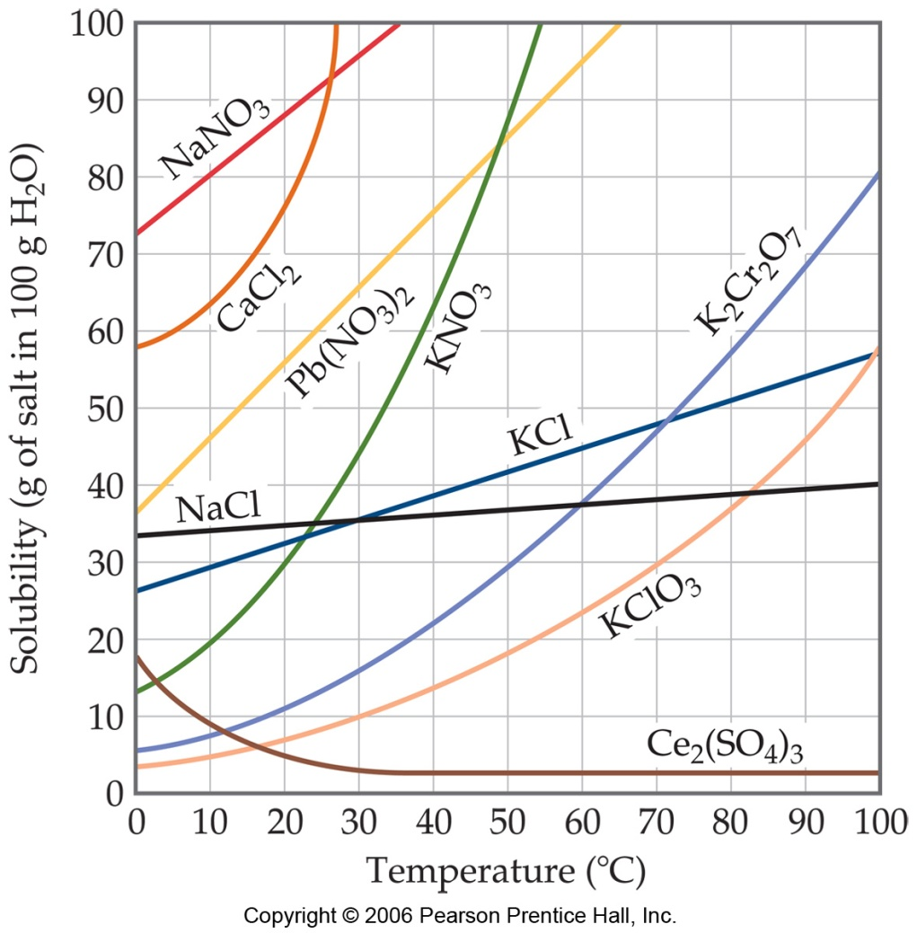
Solubility Curves
Generally, the solubility of solid solutes in liquid solvents increases with increasing temperature.

Slide 15
To read the graph, find the line for the substance. The amount that dissolves at a given temperature is on the y- axis.

Slide 16
How much KNO₃ dissolves in 100g (or 100mL H₂O at 50ºC?
1.Find the line (green)
2.Find the temperature and follow up to the line.(red arrow)
3. Read across to the y- axis and this is the answer. (blue arrow)
4. Since it is more than ½-way between 80 and 90, it is 87.

Slide 17
A point on the line is a saturated solution.
Above the line is supersaturated.
Below the line is unsaturated.

Slide 18
Using Solubility Curves
What is the solubility of NaNO₃ in 100 g of H₂O at 0°C?
How many grams of KNO₃ will dissolve in 200g of H₂O at 45°C?
How much water is needed to dissolve 190g of NaNO₃ at 30°C?

Slide 19
Using Solubility Curves
What is the solubility of NaNO₃ in 100 g of H₂O at 0°C?
How many grams of KNO₃ will dissolve in 200g of H₂O at 45°C?
How much water is needed to dissolve 190g of NaNO₃ at 30°C?
73g NaNO₃
75g = ?
100g H₂O 200g H₂O
= 150 g KNO₃
95g = 190g
100g H₂O ? g H₂O
= 200 g H₂O

Slide 20
Molarity
(M)

Slide 21
Molarity
Molarity is the concentration of a solution expressed in moles of solute per Liter of solution.
Molarity is a conversion factor for calculations
  Molarity (M) = moles of solute
  Liters of solution

Slide 22
Molarity
  M = mol (solute)
  L (solution)
Example 1: What is the molarity of a solution that has 2.3 moles of sodium chloride in 0.45 liters of solution?

Slide 23
Molarity
  M = mol (solute)
  L (solution)
Example 1: What is the molarity of a solution that has 2.3 moles of sodium chloride in 0.45 liters of solution?
2.3 moles NaCl = 5.1M NaCl
0.45 L

Slide 24
Molarity
  M = mol (solute)
  L (solution)
Example 2: How many moles of Na₂CO₃ are there in 10.0 L of 2.0 M solution?

Slide 25
Molarity
  M = mol (solute)
  L (solution)
Example 2: How many moles of Na₂CO₃ are there in 10.0 L of 2.0 M solution?
10.0 L 2.0 mol Na₂CO₃
1 1 L
= 20.0 moles Na₂CO₃

Slide 26
Molarity
  M = mol (solute)
  L (solution)
Example 3: How many moles of KNO₃ are needed to make 450. mL of 1.5 molar solution?

Slide 27
Molarity
  M = mol (solute)
  L (solution)
Example 3: How many moles of KNO₃ are needed to make 450. mL of 1.5 molar solution?
450. mL 1L 1.5 mol KNO₃
1 1000mL 1L
= .675 moles KNO₃

Slide 28
Molarity
  M = mol (solute)
  L (solution)
Example 4: How many grams of NaCl are needed to make 3.0 L of 1.5 M solution?

Slide 29
Molarity
  M = mol (solute)
  L (solution)
Example 4: How many grams of NaCl are needed to make 3.0 L of 1.5 M solution?
3.0 L 1.5 mol NaCl 58.44 g NaCl
1 1 L 1 mol NaCl
= 260 g NaCl

Slide 30
Molarity
  M = mol (solute)
  L (solution)
Example 5: How many L of 4.0 M solution can be made with 132g of NaCl ?

Slide 31
Molarity
  M = mol (solute)
  L (solution)
Example 5: How many L of 4.0 M solution can be made with 132g of NaCl ?
132 g NaCl 1 mol NaCl 1 L
1 58.44 g NaCl 4.0 mol NaCl
= .565 L

Slide 32
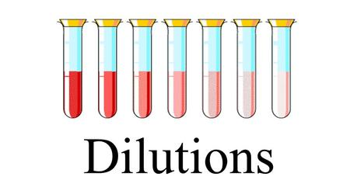
Dilutions

Slide 33
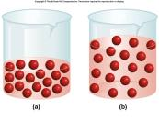
Dilutions and Molarity
Use this formula to make a more dilute solution from a concentrated solution
Molarity₁ x Volume₁ = Molarity₂ x Volume₂
(Concentrated) (Dilute)
(before) = (after)
M₁V₁ = M₂V₂

Slide 34
Example 1
How many liters of 2.5 M HCl are required to make 1.5 L of 1.0 M HCl?
M₁V₁ = M₂V₂
M₁ = 2.5 M
V₁ = ?
M₂ = 1.0 M
V₂ = 1.5 L
(2.5M) V₁ = (1.0M) (1.5 L)
= 0.60L
2.5M
2.5M

Slide 35
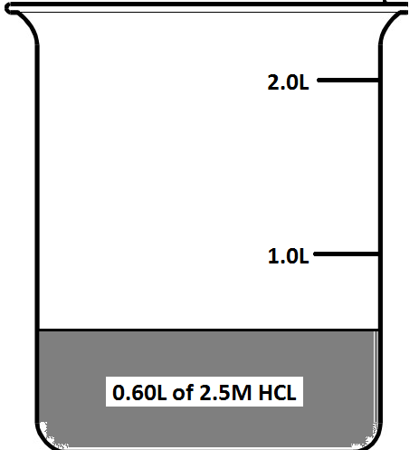
Example 1
M₁ = 2.5M V₁ = 0.60L M₂ = 1.0 M V₂= 1.5 L
How much water should you add to the volume of 2.5M HCl you calculated above to make the solution? (draw this in your notes)
1st add .60L of HCl to
measuring device.

Slide 36
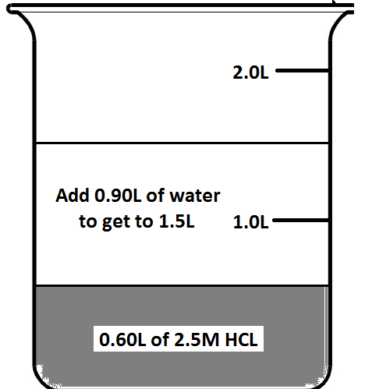
Example 1
M₁ = 2.5M V₁ = 0.60L M₂ = 1.0 M V₂= 1.5 L
How much water should you add to the volume of 2.5M HCl you calculated above to make the solution?
Then add enough water to get
to 1.5L of solution V₂ – V₁ = Amount of water
1.5L – 0.60L = 0.90L water

Slide 37
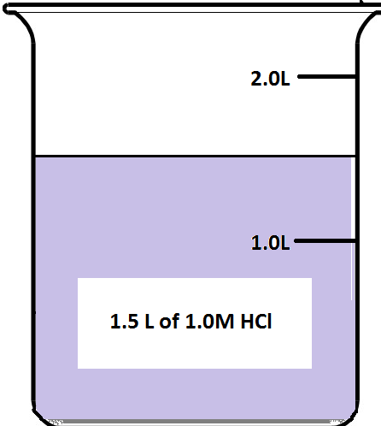
Example 1
M₁ = 2.5M V₁ = 0.60L M₂ = 1.0 M V₂= 1.5 L
How much water should you add to the volume of 2.5M HCl you calculated above to make the solution?
Final solution is 1.5L
of 1.0M HCl

Slide 38
Example 2
250.0 mL of a 0.500 M HCl solution needs to be made from concentrated HCl. What volume of the concentrated solution is needed if its molarity is 12.0 M?
M₁V₁ = M₂V₂
M₁ =
V₁ =
M₂ =
V₂ =

Slide 39
Example 2
250.0 mL of a 0.500 M HCl solution needs to be made from concentrated HCl. What volume of the concentrated solution is needed if its molarity is
12.0 M?
M₁V₁ = M₂V₂
M₁ = 12.0M
V₁ = 10.4mL
M₂ = 0.500M
V₂ = 250.0mL
How much water would you
add to make the final
solution?
250.0mL - 10.4mL = 239.6mL

Slide 40
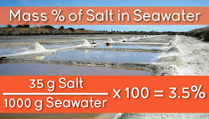
Mass Percent

Slide 41
Mass Percent
Solutions can also be represented as percent of solute in a specific mass of solution.
For a solid dissolved in water, you use percent by mass which is Mass Percent.
% by mass = mass solute x 100
mass of solution
**Mass of solution = solute mass + solvent mass

Slide 42
Example 1
If a solution that has a mass of 800.0 grams contains 20.0 grams of NaCl, what is the concentration using Percent by Mass?

Slide 43
Example 1
If a solution that has a mass of 800.0 grams contains 20.0 grams of NaCl, what is the concentration using Percent by Mass?
% by mass = mass solute x 100
mass of solution
% by mass = 20.0g NaCl x 100
800.0g solution
= 2.50% NaCl

Slide 44
Example 2
If 10.0 grams of NaCl is dissolved in 90.0 grams of water, what is the concentration using Percent by Mass?

Slide 45
Example 2
If 10.0 grams of NaCl is dissolved in 90.0 grams of water, what is the concentration using Percent by Mass?
% by mass = mass solute x 100
mass of solution
% by mass = 10.0g NaCl x 100 = 10.0%NaCl
100.0g solution

Slide 46
Example 3
How many grams of sodium bromide are in 200.0g of solution that is 15.0% sodium bromide by mass?

Slide 47
Example 3
How many grams of sodium bromide are in 200.0g of solution that is 15.0% sodium bromide by mass?
% by mass = mass solute x 100
mass of solution
% by mass = ? g NaBr x 100 = 15.0%NaBr
200.0g solution
g NaBr = 200.0 x 15.0
100
= 30 g NaBr

Slide 48
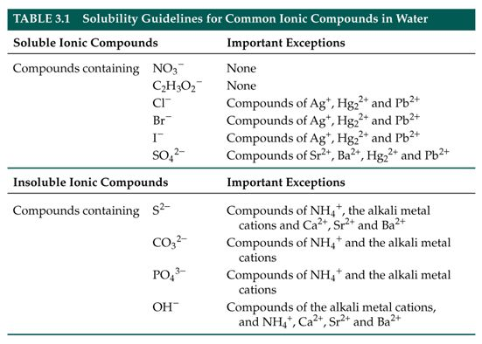
Solubility Chart
How to use

